Slide 1
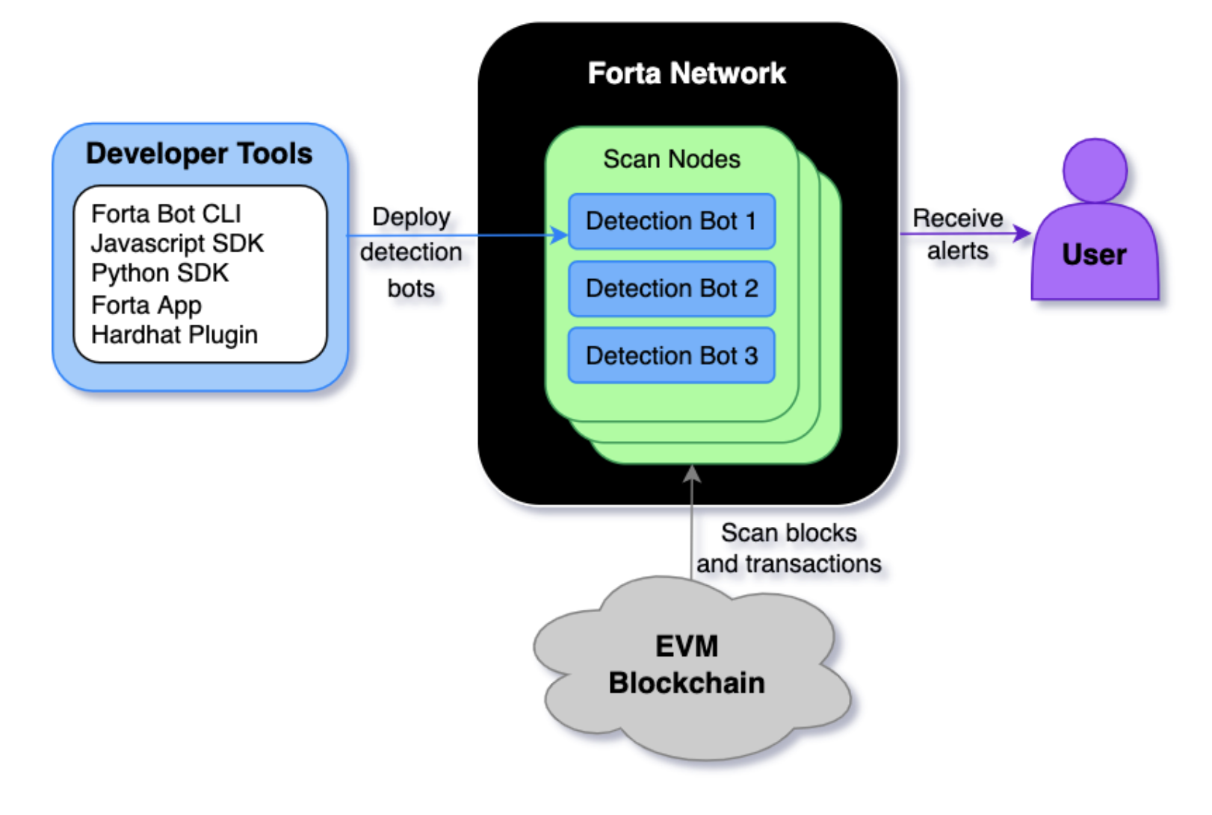
This and ether.js is all we need to use

Slide 2
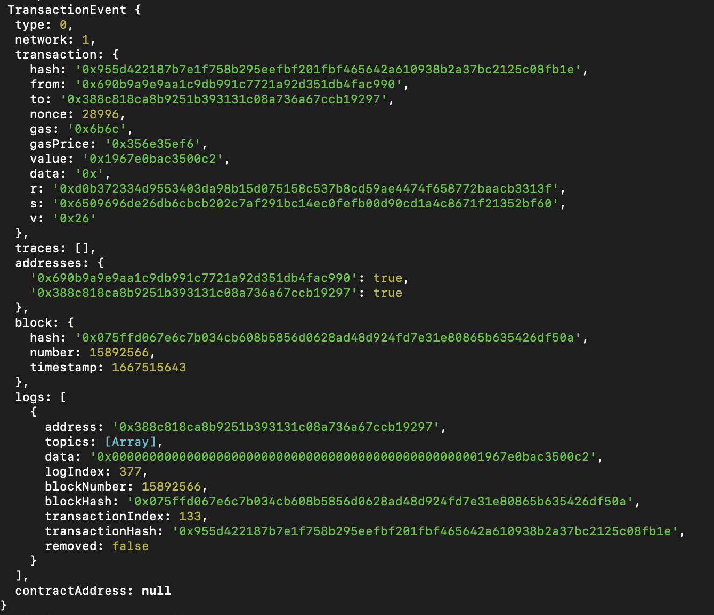

Slide 3
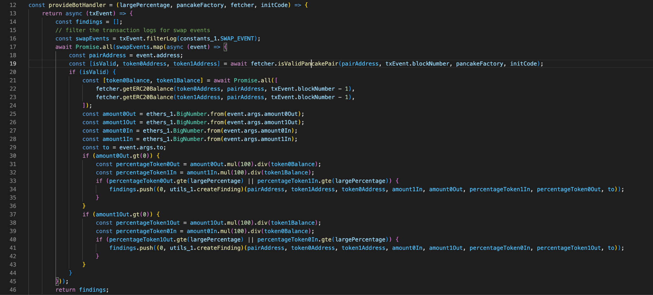

Slide 4
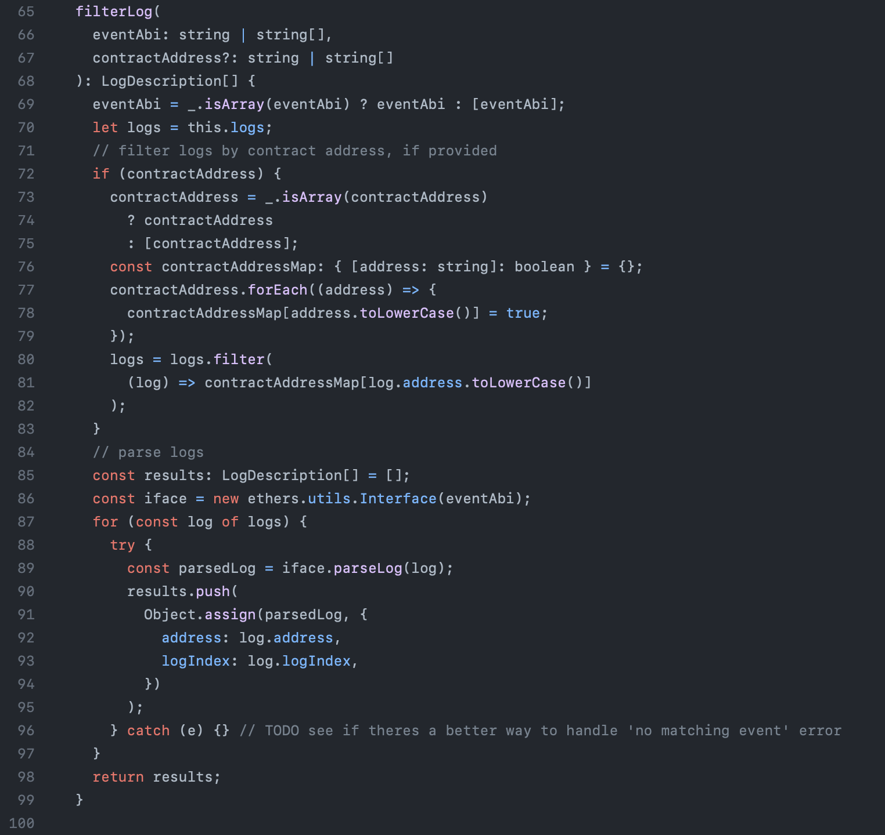
forta-bot-sdk
https://github.com/forta-network/forta-bot-sdk/blob/master/sdk/transaction.event.ts

Slide 5
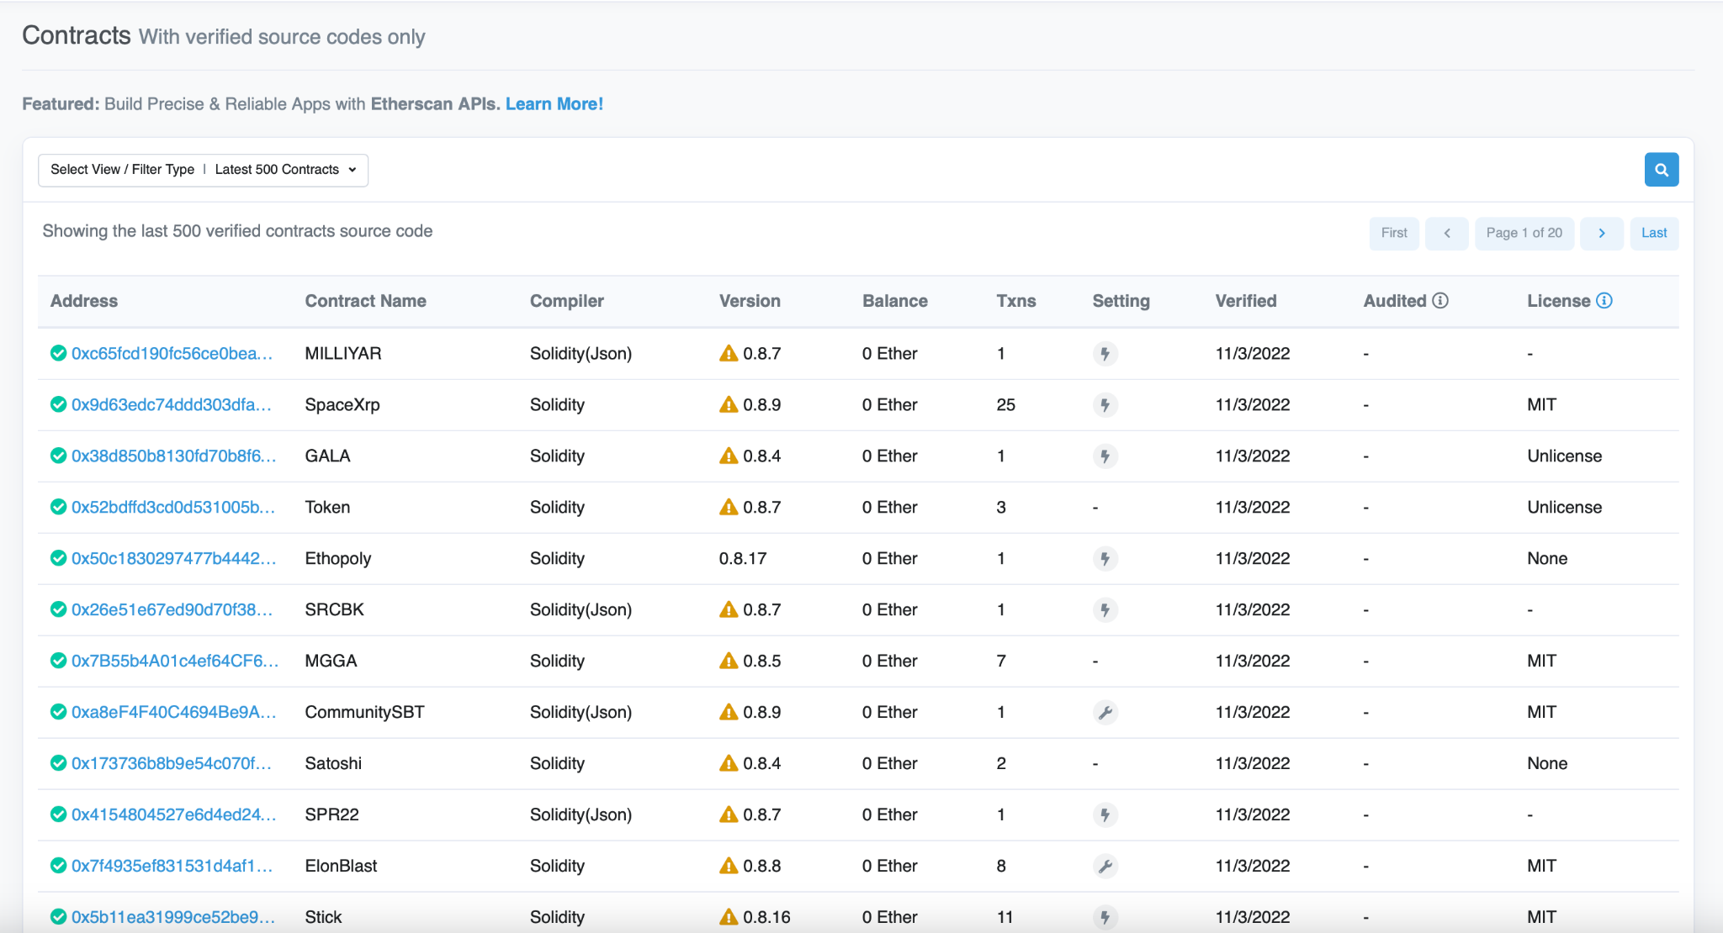
We can use scrapy to fetch the contracts on the Ethereum network
https://etherscan.io/contractsVerified

Slide 6
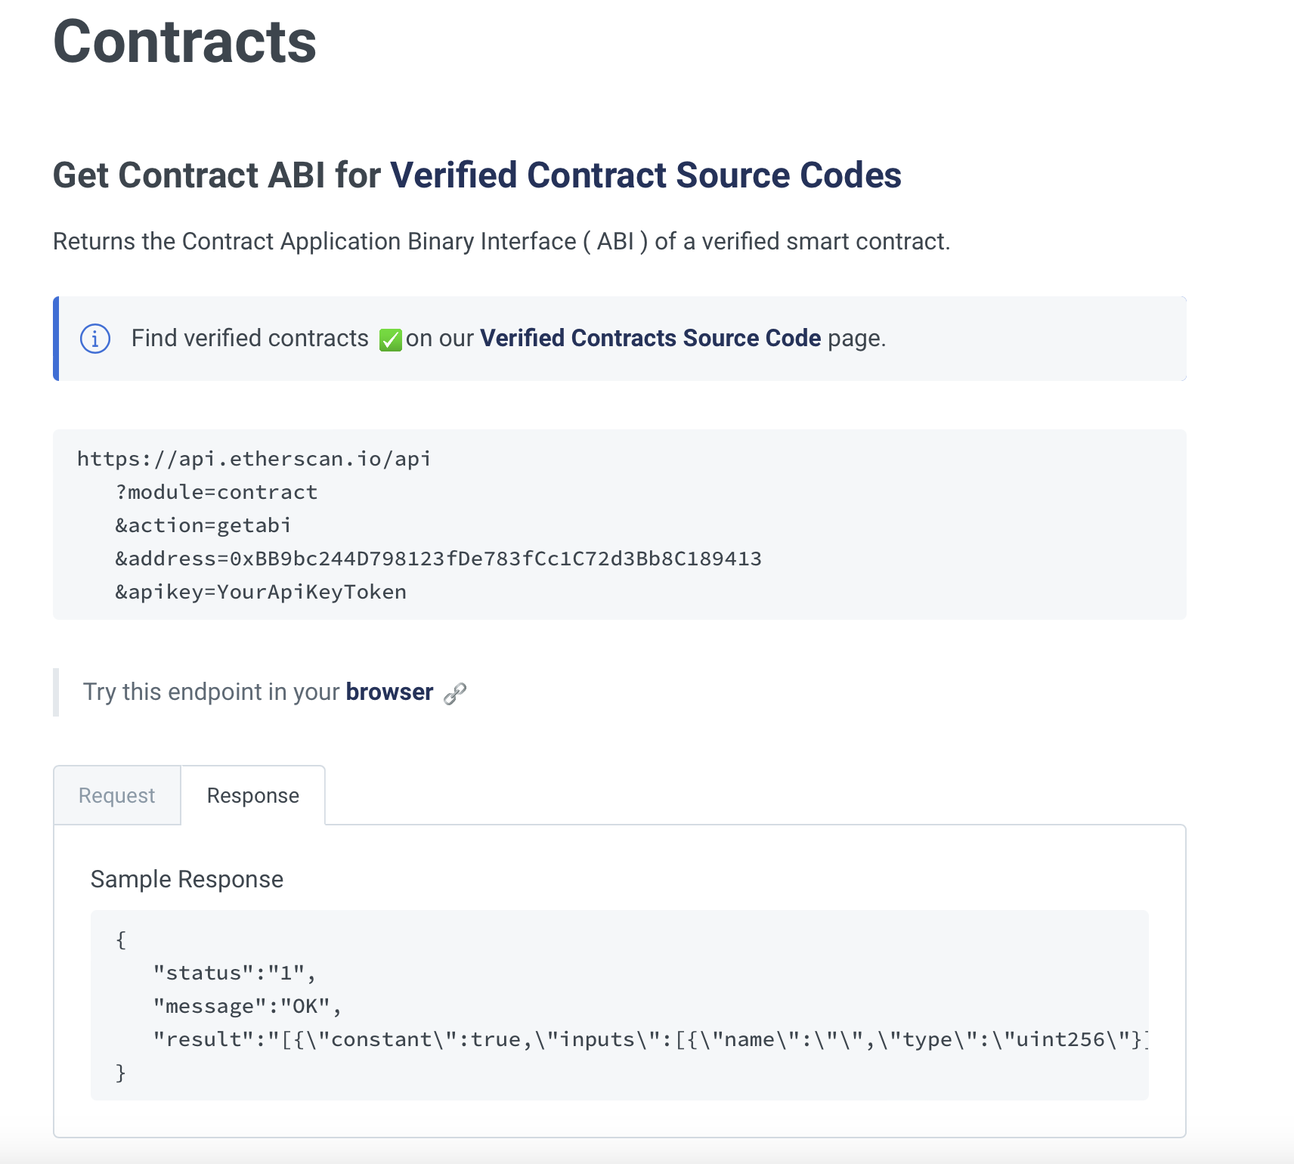
Removes the manual task of looking up ABIs for the contracts we are interested in
https://docs.etherscan.io/api-endpoints/contracts

